Slide 1

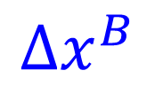
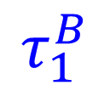
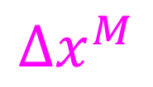
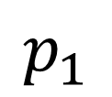
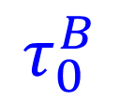
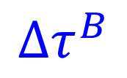
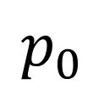
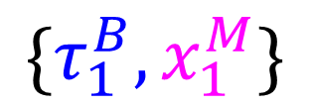
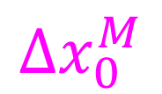
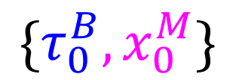
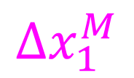
$$Δx_{0}^{M}$$
$$\{τ_{0}^{B},x_{0}^{M}\}$$
$$τ_{0}^{B}$$
$$p_{0}$$
$$Δτ^{B}$$
$$Δx^{B}$$
$$Δs^{M}$$
$$p_{1}$$
$$τ_{1}^{B}$$
$${\{τ_{1}^{B},x}_{1}^{M}\}$$
$$Δx^{M}$$
$$Δx_{1}^{M}$$

